Slide 1
Software Engineering Desing Project
Choosing and setup SCM

Slide 2
Software Engineering Desing Project
INDEX:
criteria for choosing a SCM
account creation
team management
setup repositories
setup GitHub on windows
setup GitHub in Eclipse

Slide 3
Software Engineering Desing Project
Criteria for choosing a SCM:
defintion and tracking of processes
documentaion of all procedures
version control and conflict management
management of requirements
access control

Slide 4
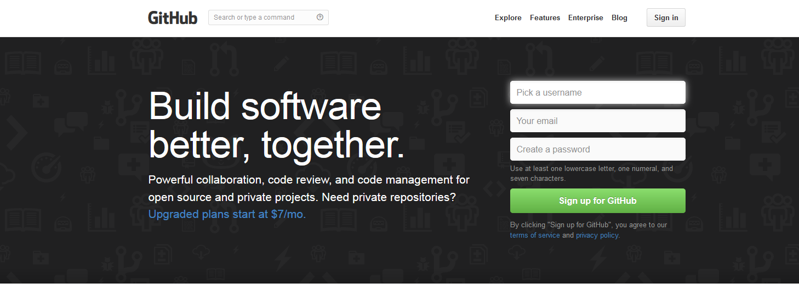
Software Engineering Desing Project
Account creation(GitHub):
visit the GitHub homepage https://github.com/

Slide 5
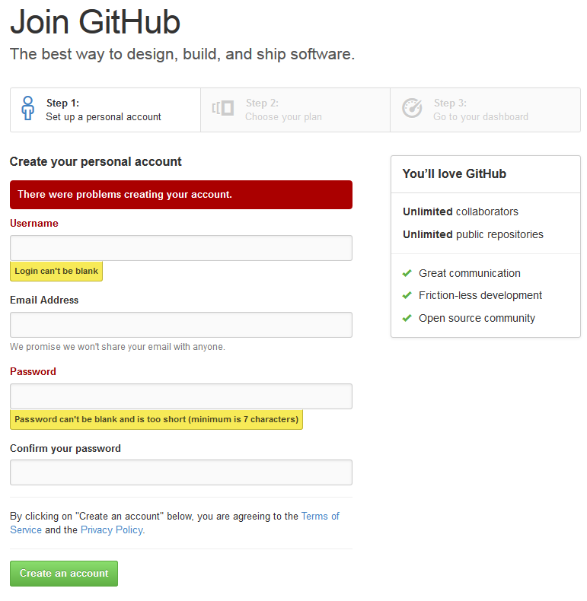
Software Engineering Desing Project
Account creation
(GitHub):
fillout the registration
sheet and follow the
registration steps

Slide 6
Software Engineering Desing Project
Team management:
create new organisation
invite team members
create workspace by creating the first repository (directory)

Slide 7
Software Engineering Desing Project
Setup repositorys:
create repository in your new organization by following the GitHub instructions
repository is a reference to a folder or directory on a local computer
create a README.txt for each repository

Slide 8
Software Engineering Desing Project
Setup GitHub on Windows:
download the GitHub client
you can use the interface based or the shell based software for repository management
login to GitHub through the client
look up your repositories and create local clones of the repository you need

Slide 9
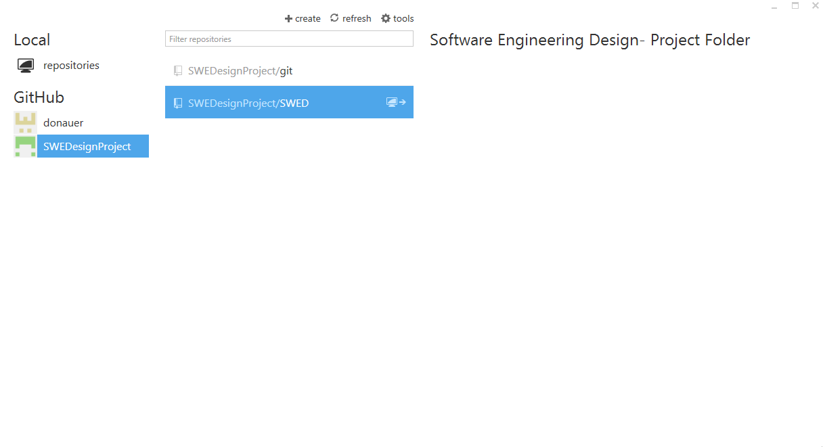
Software Engineering Desing Project

Slide 10
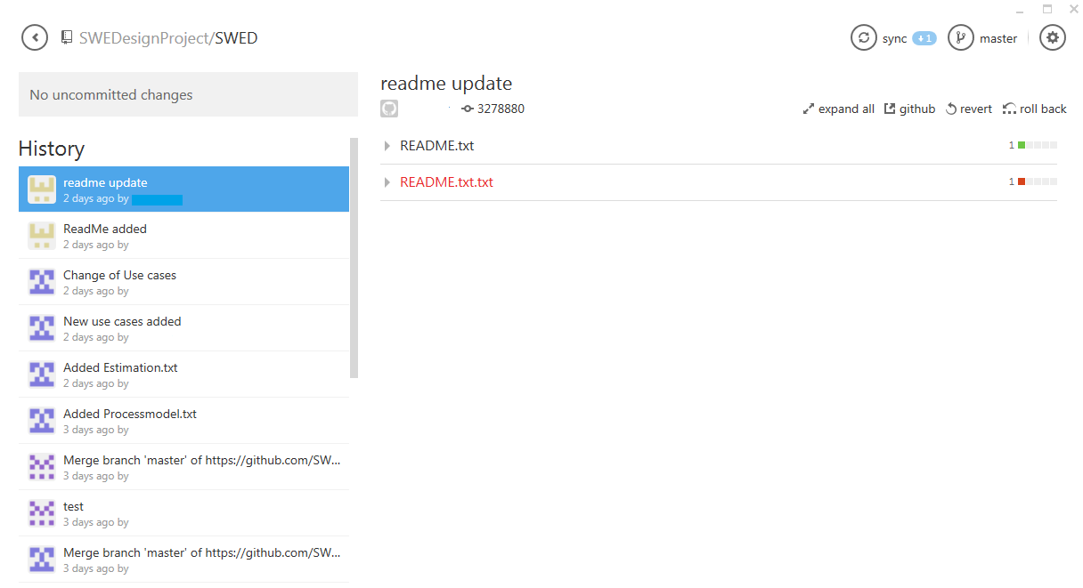
Software Engineering Desing Project

Slide 11
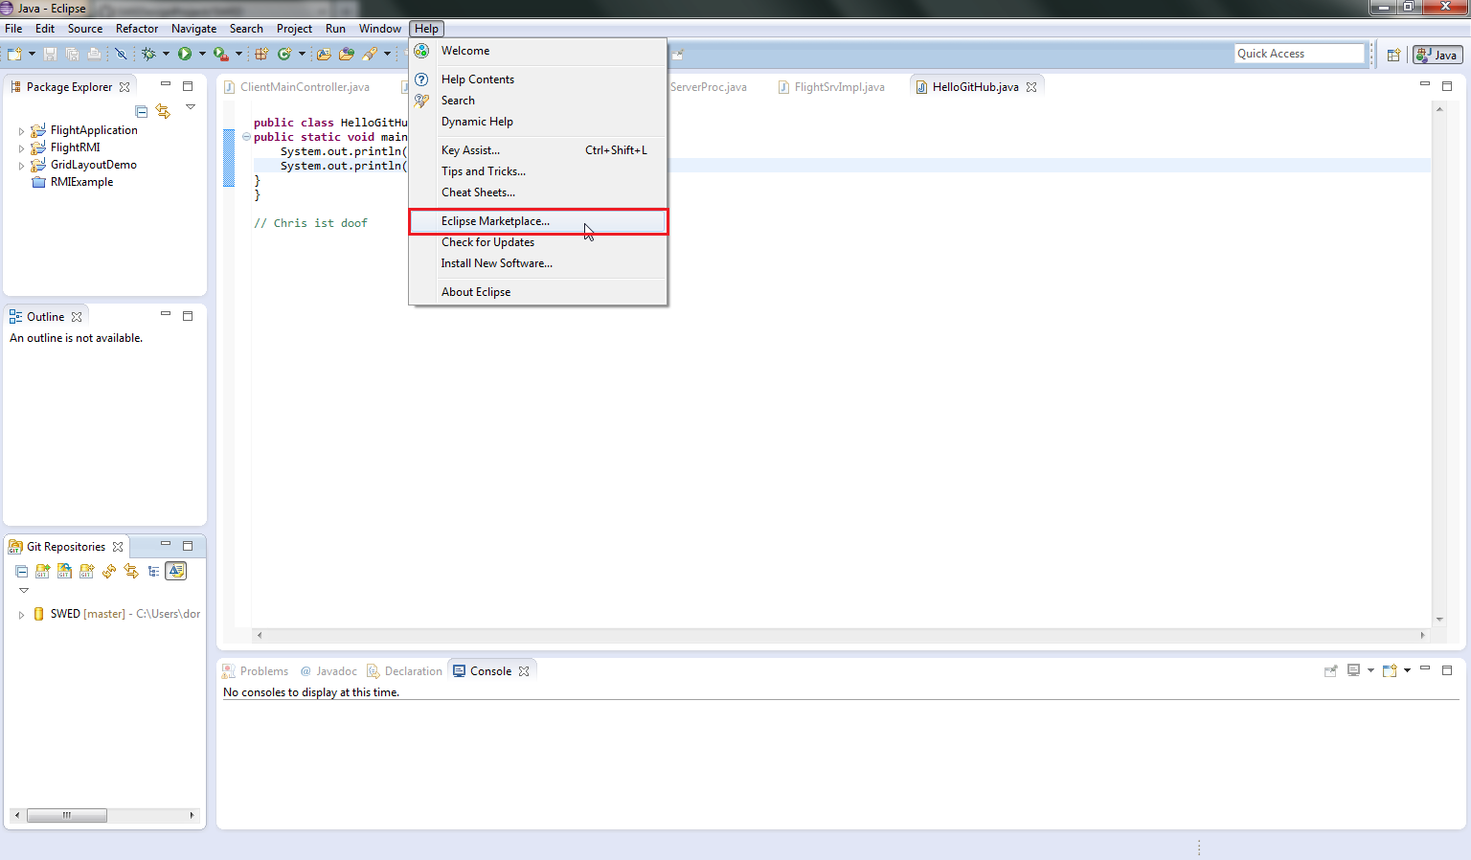
Software Engineering Desing Project
Setup GitHub on Eclipse:
Download eGit from Eclipse Marktplace

Slide 12
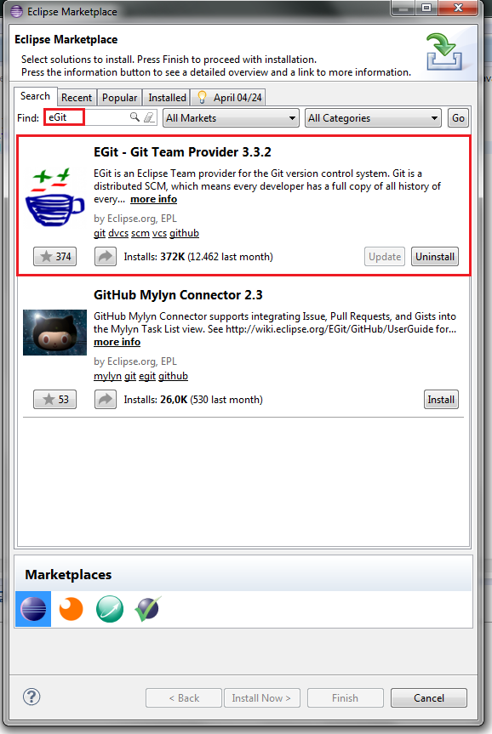
Software Engineering Desing Project
Setup GitHub on Eclipse:
there are different addons
that works with GitHub

Slide 13
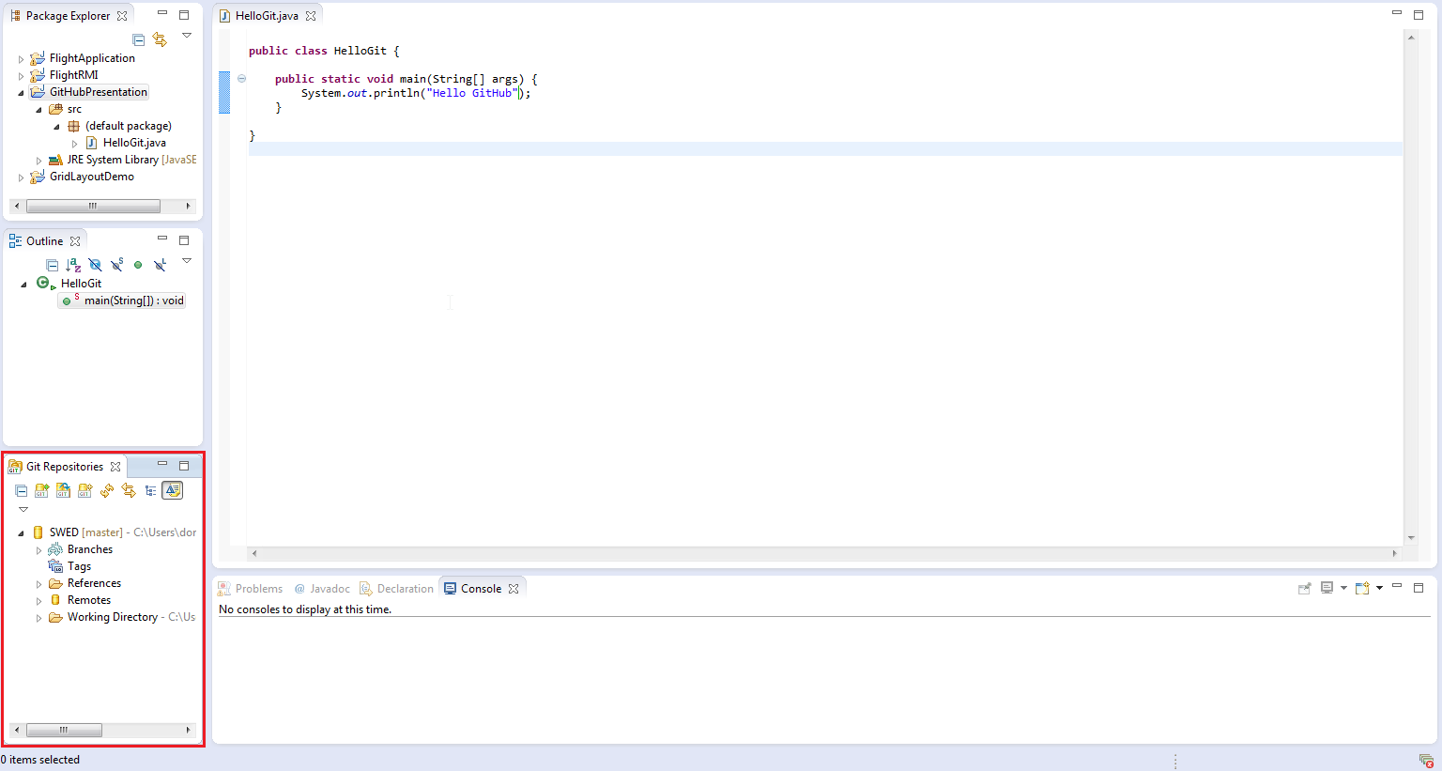
Software Engineering Desing Project

Slide 14
Software Engineering Desing Project
Setup GitHub on Eclipse:
Add the eGit view to your interface
Add the local GitRepository or load a repository from GitHub server

Slide 15
Software Engineering Desing Project
Setup GitHub in eclpise:
How to upload new or modified project code:
Create new code part or modify old versions
Add the data to the repository
Confirm your changes
Upload confirmed changes

Slide 16
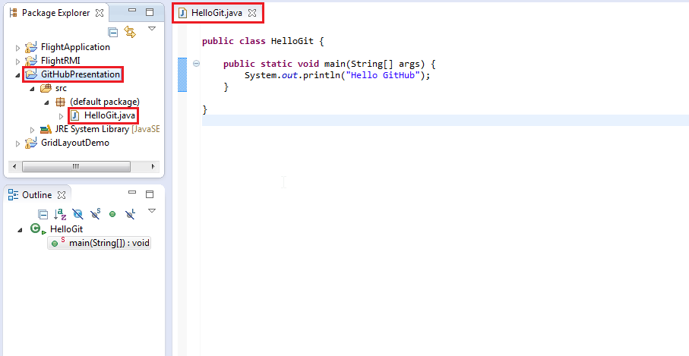
Software Engineering Desing Project

Slide 17
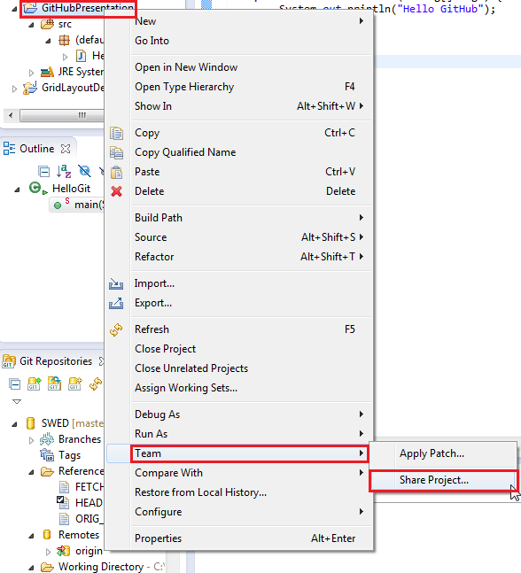
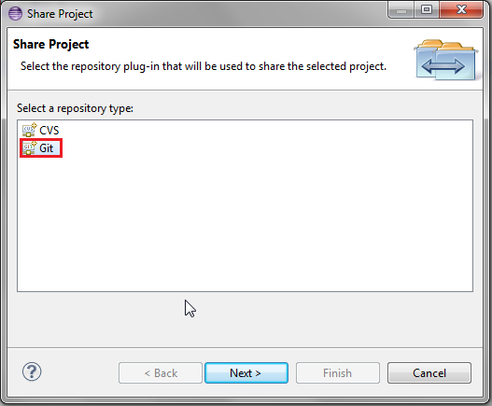
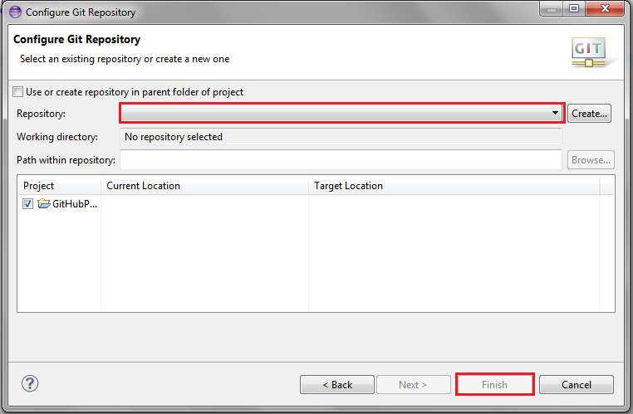
Software Engineering Desing Project

Slide 18
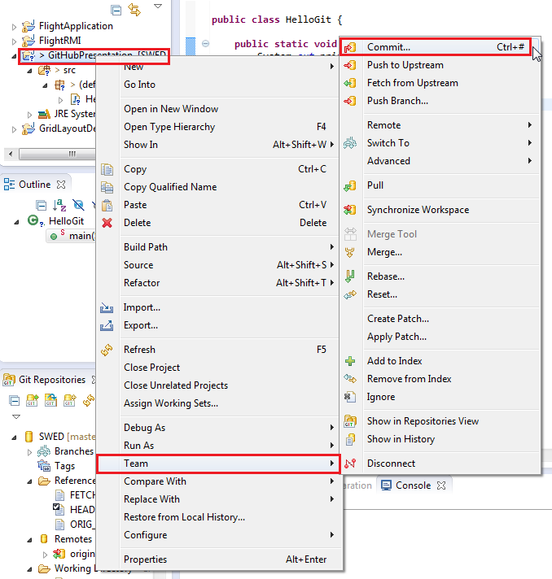
Software Engineering Desing Project

Slide 19
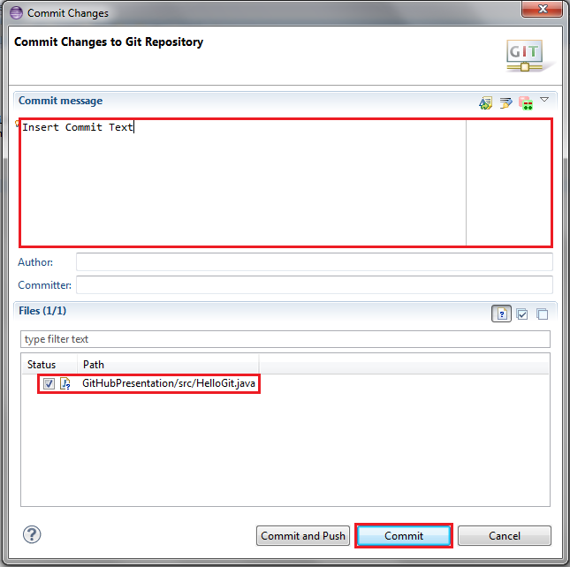

Software Engineering Desing Project

Slide 20
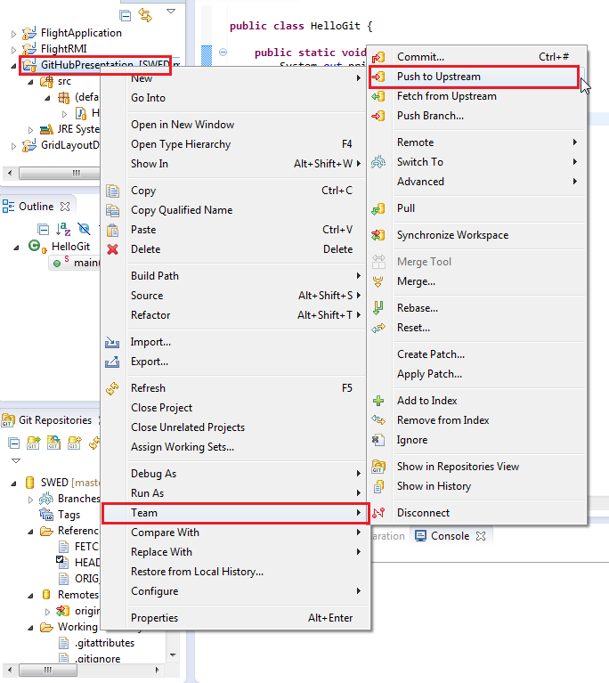
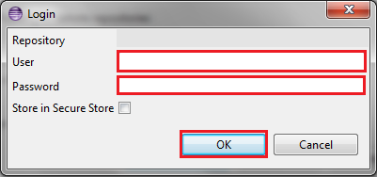
Software Engineering Desing Project

Slide 21
Software Engineering Desing Project
Thank you for your attention

Slide 22
Software Engineering Desing Project
Sources:
https://github.com/

